Slide 1
Diagnostic Assessments

Slide 2
https://educatingnow.com/blog/diagnostic-assessments-good-bad/

Slide 3
Objectives
Define diagnostic assessments
1
Determine ways to use diagnostic assessment
2
Apply diagnostic assessment results to course design and delivery
3
Examine examples of diagnostic assessments
4
Discuss the benefits and barriers to diagnostic assessments
5

Slide 4
What’s a Diagnostic Assessment
” Diagnostic assessments are intended to help teachers identify what students know and can do in different domains to support their students’ learning. These kinds of assessments may help teachers determine what students understand in order to build on the students’ strengths and address their specific needs.”
Guidance with Diagnostic and Formative Assessments

Slide 5
Where does it fit?
Diagnostic
Formative
Summative
BEFORE
DURING
END

Slide 6
Components
Happen
Happen at the beginning of a unit, lesson, quarter, or period of time.
Goal
Goal of understanding student’s current position to inform effective instruction
Identify
Identify strengths and areas of improvement for the student
Low
Low-stakes assessments (Usually do not count as a grade)
https://edulastic.com/blog/diagnostic-assessment/

Slide 7
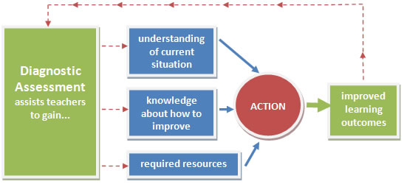

Slide 8
Types of Diagnostic Assessments
Informal
Standardized

Slide 9
Types of Diagnostic Assessments
Journals
Quiz/test
Conference/interview
Posters
Performance tasks
Mind maps
Self Assessments
Student surveys

Slide 10
Assessing prior knowledge
Direct Measures
Tests
Concept Maps
Auditions
Indirect Measures
Self reports
Transcripts

Slide 11
Identifying Learner Needs
Cognitive
Social
Affective
Psychomotor

Slide 12
Using the data
Identify strengths and weaknesses among the class
1
Identify and correct misconceptions
2
Adapt instructional approach
3
Provide additional support materials
4
Acknowledge student needs, concerns, and/or challenges
5

Slide 13
Benefits
Insight to customize instruction
Easy to use/ Informal
Do not need to follow standardized protocols
Quick results
Helps eliminate student frustration
Alerts instructor to potential issues

Slide 14
Barriers
Short term
Students may not take an ungraded assessment seriously
Open to inaccurate assumptions
Student anxiety
Time-consuming

Slide 16
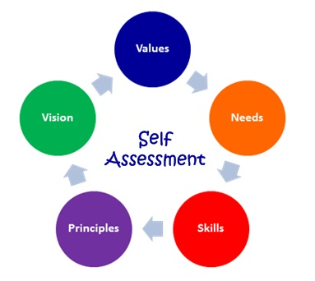

Slide 17
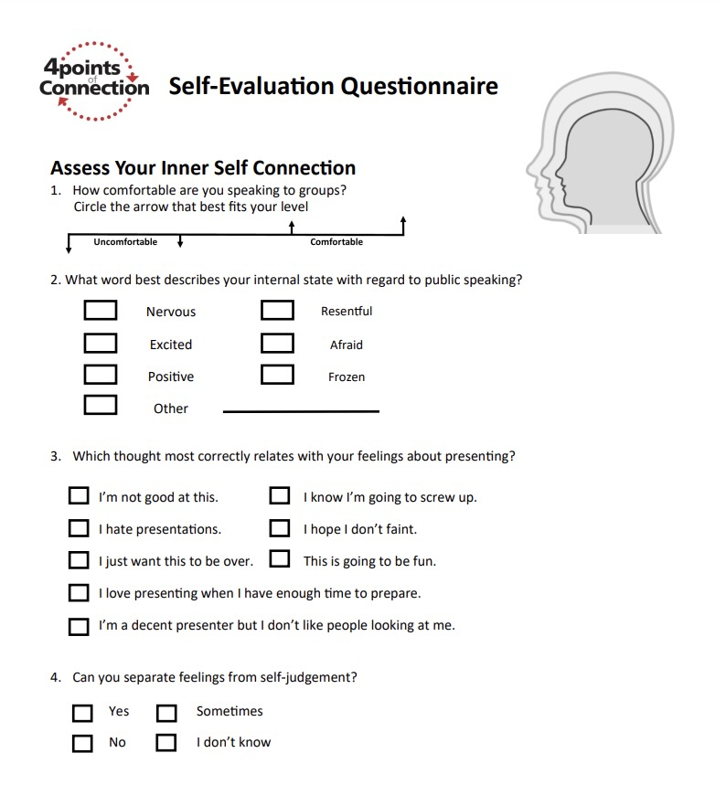

Slide 18
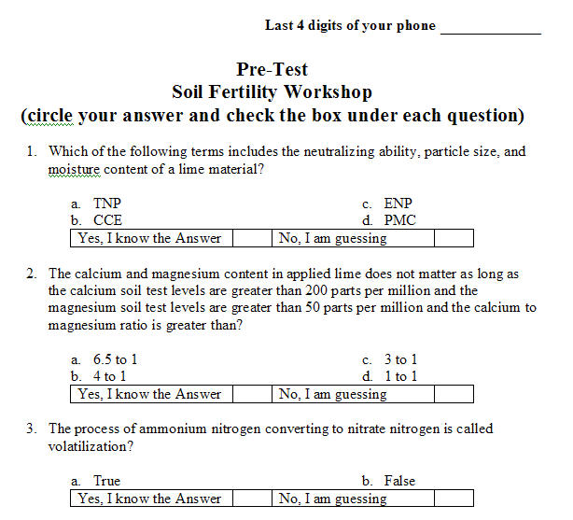

Slide 19
Introductory Email
Dear Students, Welcome to your course. Please respond to this email and answer the following questions:
What is your experience with the concepts covered in this course?
Is there anything I should know about you that might interfere with your ability to be successful in this course?
What are your general feelings about this course?

Slide 20
What’s Next….
Create a diagnostic assessment for your class. Choose from any that were mentioned in this workshop or make up your own. Consider the data you want to collect and how you will use it.

Slide 21
References
https://harappa.education/harappa-diaries/diagnostic-assessment/
https://work.chron.com/diagnostic-assessment-4165.html
https://www.cde.ca.gov/ls/he/hn/guidanceonassessments.asp#:~:text=Diagnostic%20assessments%20are%20intended%20to,and%20address%20their%20specific%20needs.

