Slide 1
Bonnie Ordonez; EdD Dean
Hyflex Classroom Model

Slide 2
Objectives
Review components of HyFlex model
Discuss design of a HyFlex Course
Consider the Pros and Cons of HyFlex Course Design
Explore the HyFlex options at PTC

Slide 3
What is Hyflex?
Combination of face to face and online learning
Course is offered in different formats: in-person, synchronously online, and asynchronously online
Student can decide how they would like to participate
All students have equal access to learning resources and activities
Merging of technology, course design, focus on pedagogy and the engagement of the students

Slide 4
How does it work?
All Education Resources must be online
Students who join online must have access to live, persistent chat
You may need a chat Moderator who can track questions and responses during live session
Wide range of flexibility not found in Remote teaching or Hybrid teaching

Slide 5
Why Hyflex?
HyFlex courses provide maximum flexibility and therefore, could potentially increase enrollment.
HyFlex gives the students a choice that may result in higher outcomes because students can pick their modality.
HyFlex can alleviate attendance issues due to jobs, illness, weather concerns, athletics, or childcare issues.

Slide 6
Establish Priorities in your Course
What is crucial?
What is important to course completion?
What is worthwhile to include?

Slide 7
Sequencing Lecture
Chunk lecture topics into logical parts
Allow opportunities for breaks
Begin with a formal introduction
End with a formal closing

Slide 8
Checklist
Provide a checklist for what should be completed each week.
Distinguish between optional and required activities.

Slide 9
Selecting Materials
Choose material carefully for format
Do Not Overload materials
Provide directions on how and when to use materials
(should the students complete reading prior to lecture, should their book be present during class, etc…)
Consider the relationship between lectures, materials, and activities

Slide 10
Lecture Considerations
Do you walk around?
Are you soft spoken?
Repeat questions from in class students for all to hear
Consider students in all 3 modalities

Slide 11
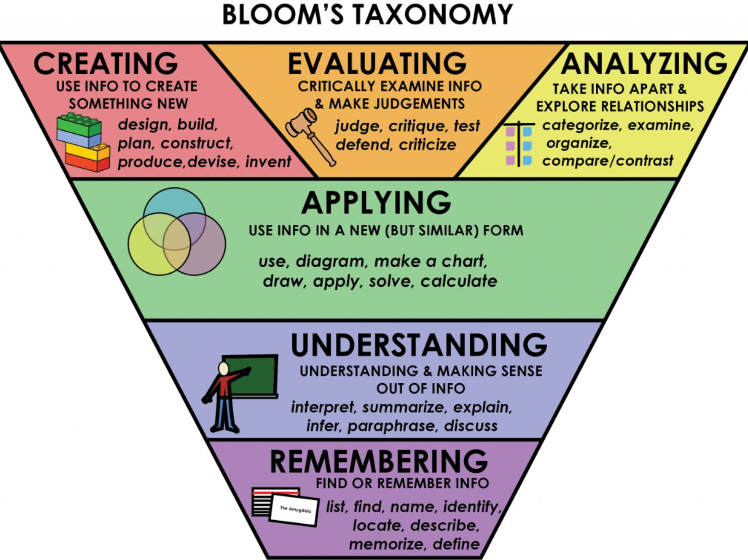
Course Activities

Slide 12
Lecture Flow
Intro
Topic 1
Activity
Topic 2
Activity
Topic 3
Close

Slide 13
Outcomes | Course Materials | Activities | Lecture Content | Assessment
Discuss the learning theory, Behaviorism | Websites Textbook | Create a mnemonic to remember main attributes of Behaviorism | Presentation on Behaviorism and main traits | Submission of Mnemonic with correct attributes
Identify leading behavioral theorists | Chart template | Research on web, complete chart | Use polling tool to ask questions about theorists | Submit Chart to Assignment Window in Blackboard
Relate behaviorism to personal learning experiences | Google Doc with Prompt | Minute paper | Discuss example of behavioral theory in action | Submit in LMS Discussion Board

Slide 14
You will need…
• Video streaming device and software (Zoom, Web Ex, Teams) • Camera (SWIVL or iPad) • Web Cam • Smart Phone
• Projector/Screen in Classroom (Helpful to have two screens or a monitor)
• Learning Management System • Real time Chat • Electronic Resources available during session
• Moderator

Slide 15
Pros Cons
Allows for Social Distancing •
Live Audience
Can give more attention to • students who need it
Students have control over • learning
Performance does not fall off • using this model
Faculty Planning and oversight of all students
Engaging all learners in different formats
In-person numbers will dwindle
Students must take greater responsibility

Slide 16
iPad Stands
Getting started
Tap Screen
Click on Bb
Login
Select Course and Collaborate

Slide 17
Swivl

Slide 18
Swivl

Slide 19
Resources
Brian Beatty’s Open Source Book: https://edtechbooks.org/hyflex
Jenae Cohn Blog: https://www.jenaecohn.net/2020/06/09/hy brid-hyflex-online-and-everything-in- between-course-models-at-a-glance/
Educause White Paper: https://library.educause.edu/- /media/files/library/2020/7/eli7173.pdf

