Slide 1
Summative Assessment

Slide 3
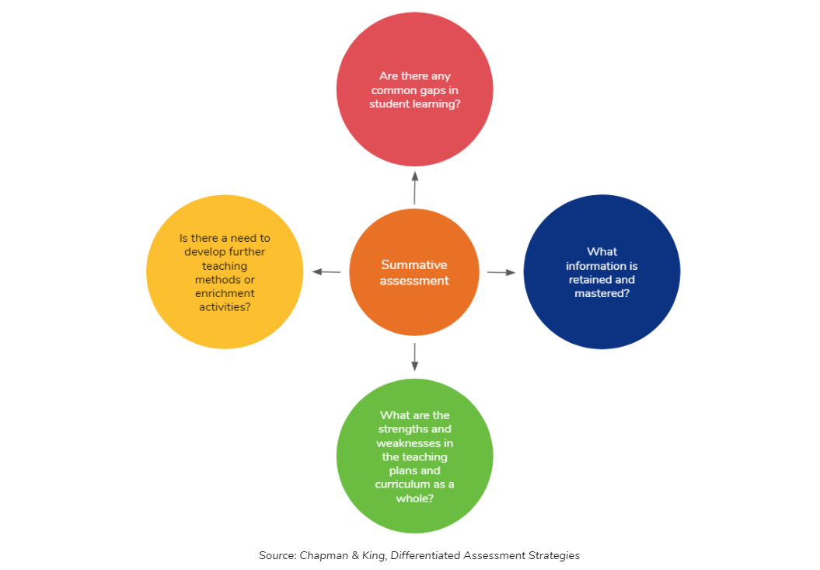

Slide 4
Objectives
Discuss purpose of Summative Assessments
Review types of Summative Assessments
Explore design of effective Summative Assessments
Determine effective strategies for implementing Summative Assessments
Compare benefits and pitfalls of Summative Assessments

Slide 5
What are summative assessments?
An evaluation of student learning at the conclusion of a unit or course.
Often determines grade in the course.
Can consist of exams or authentic assessments like presentation or essays.

Slide 6
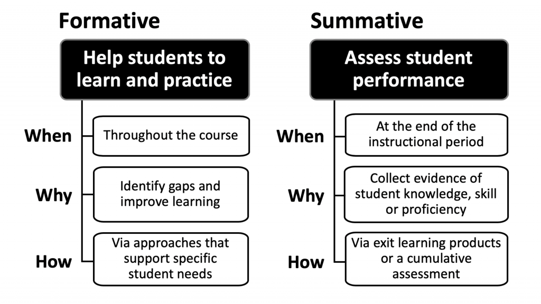
https://educationaltechnology.net/formative-and-summative-assessment/

Slide 7
Purpose of Summative Assessments
Evaluate student learning at the conclusion of instructional period, unit, course, or program.
Typically graded
Often high stakes
Often formal and standardized

Slide 8
Things to consider….
Summative assessments are generally higher-stakes
Students may exhibit anxiety over certain types of assessments
It is vitally important that summative assessments clearly align with goals and outcomes

Slide 9
Best Practices
Use a rubric
1
Design clear questions
2
Assess comprehensiveness
3
Set clear parameters
4
Consider blind grading
5

Slide 10
Considerations when Designing Summative Assessments
Class size
Modality
Level: Undergraduate/ Graduate/ Freshman/Seniors
Major Coursework
Assessment Tools

Slide 11
Designing Effective Test Questions
Multiple Choice Questions:
Consist of 1.) Question Stem, 2) Choices (including distractors and one correct response)
Include a minimum of 3 options
Create a clear stem
Use positive construction techniques (avoid “not” or ”except”)
Utilize misconceptions as distractors
Avoid “All of the Above” or “None of the Above”

Slide 12
Assessment in the Online Environment
Combat
Combat Academic Integrity Concerns
Ask
Ask students to explain their thinking
Consider
Consider assessment type
Use
Use short answer items
Implement
Implement written work
Use
Use portfolio
Ask
Ask students to submit a recorded presentation

Slide 13
Implementing Summative Exams
Don’t try to assess “everything.” Determine what is essential.
Design performance tasks
Break larger tasks into smaller events
Consider oral defense
Utilize technology
Teach academic honesty
Match cognitive level of learning objectives
Use judgment when assessing

Slide 14
Make a case for authentic assessments
Eliminates test anxiety
Utilize higher order thinking skills
Direct tie to objectives and outcomes

Slide 15
Validity, Reliability, and Manageability
Validity = Alignment to course objectives
Reliability = consistency or accuracy of assessment
Manageability = Faculty and student workload

Slide 16
Feedback and Summative Assessments
Timely and constructive
Identify specific qualities
Include actionable steps to improvement
Motivate and encourage
Explain grade criteria and score (utilize rubric)
Direct feedback to assignment rather than student
“You had 10 spelling errors” vs “10 spelling errors in the paper”

Slide 17
Culturally Responsive Assessments
In what ways does the assessment make reference to culture?
How does the assessment allow students to draw from their cultural fluencies?
How does the assessment support students in bridging their social/cultural identities with their academic identities?

Slide 18
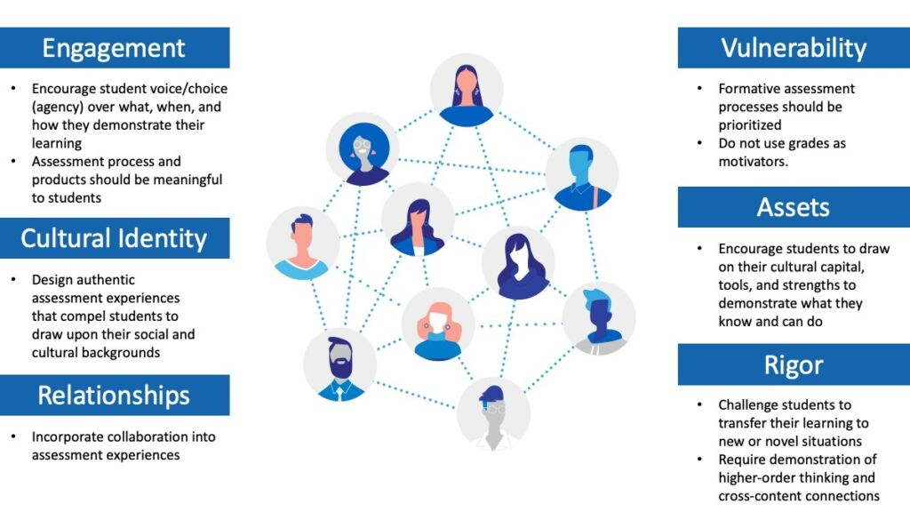
Figure 1: Stembridge’s (2020) Six Themes of Culturally Responsive Education Applied to Classroom Assessment

Slide 19
Examples of Summative Assessments
Mid-term and Final Exams
Final Projects
Final Essays
Final Presentations
Final Reports
Final Performance

Slide 20
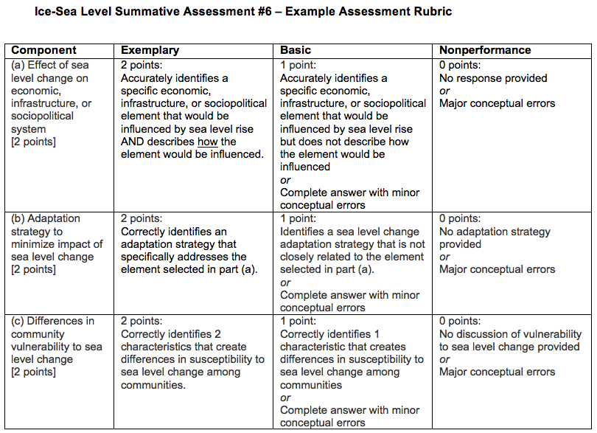

Slide 21
References
https://poorvucenter.yale.edu/Formative-Summative-Assessments
https://www.edutopia.org/article/summative-assessment-distance-learning
https://teaching.uic.edu/resources/teaching-guides/assessment-grading-practices/summative-assessments/
https://ies.ed.gov/ncee/edlabs/infographics/pdf/REL_PA_Culturally_Responsive_Assessment.pdf
https://www.nciea.org/blog/a-culturally-responsive-classroom-assessment-framework/

